Slide 1
How To:
Open TIBCO Spotfire

Slide 2
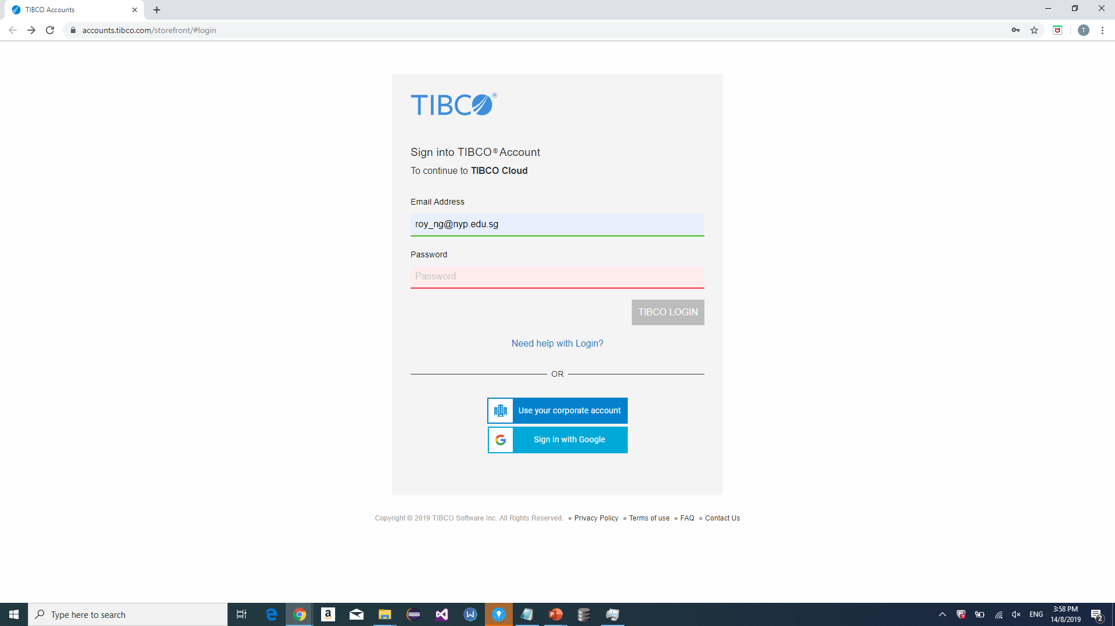
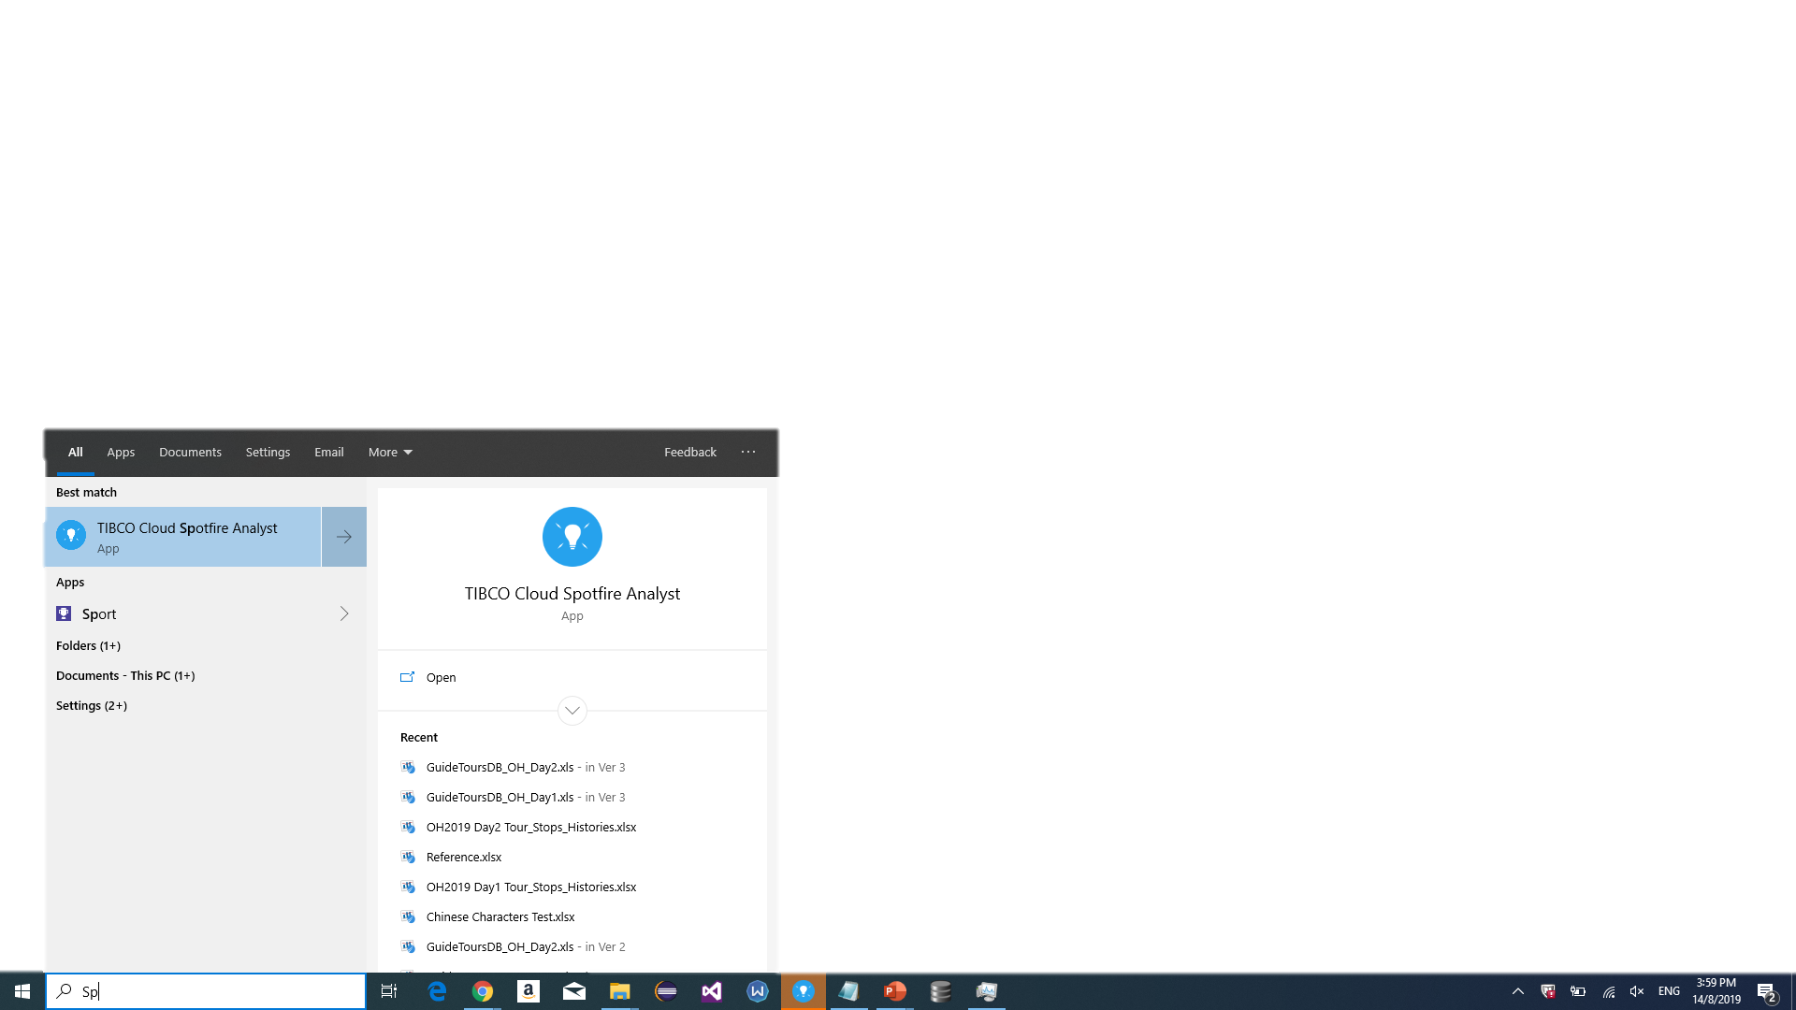
Step 1
Browser Login Opens
Enter following username and password
2.
1.
tibcor0y

Slide 3
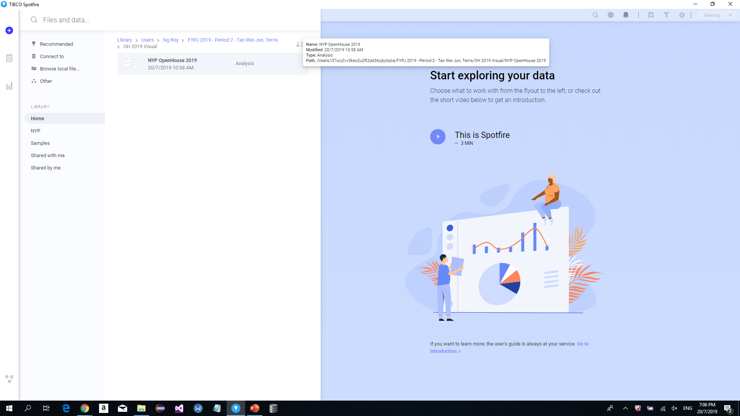
Step 2
1.
3. Navigate to this file path
4. Click on Analysis
2.
Note:
Data sources for this Analysis uses “Stored Data”.
No connection to a data source is required.

Slide 4
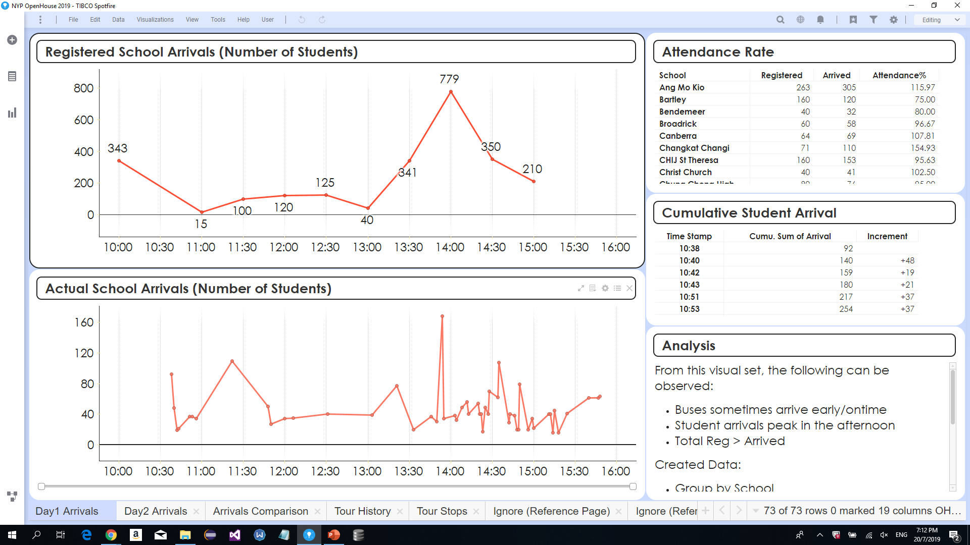
Step 3
1.

Slide 5
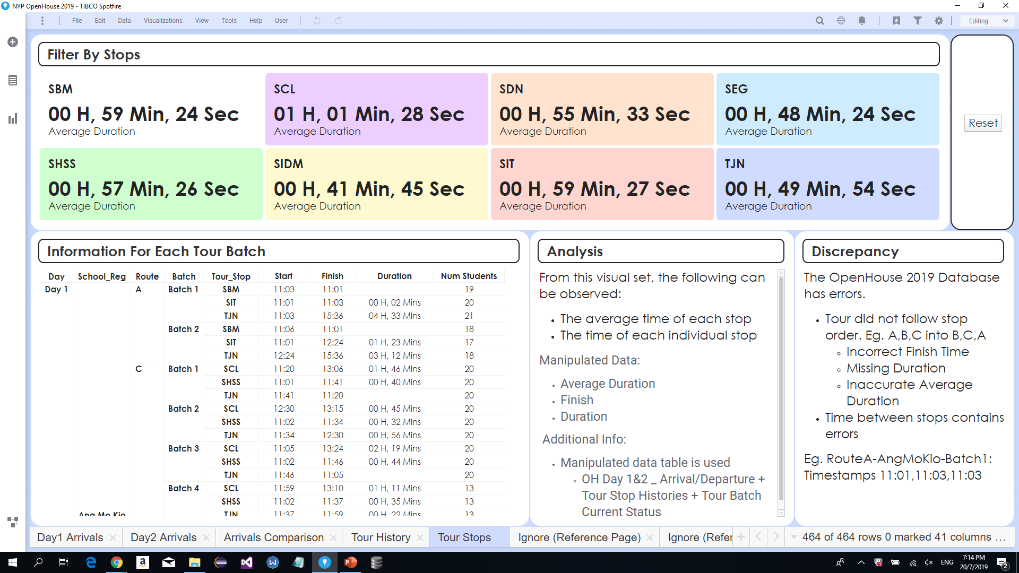
Step 4
Click to reset filter
Views data tables

